Slide 1
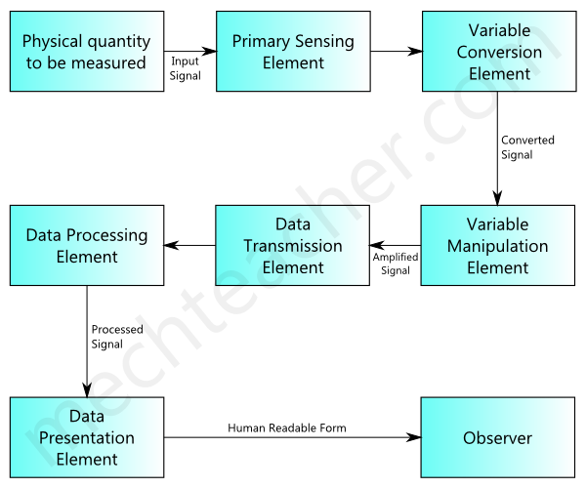
BLOCK DIAGRAM OF GENERALIZED MEASUREMENT SYSTEM

Slide 2
Components of Generalized Measurement System
Primary Sensing Element
Variable Conversion Element
Variable Manipulation Element
Data Processing Element
Data Transmission System
Data Presentation Element

Slide 3
Primary Sensing Element
The primary sensing element receives signal of the physical quantity to be measured as input. It converts the signal to a suitable form (electrical, mechanical or other form), so that it becomes easier for other elements of the measurement system, to either convert or manipulate it.

Slide 4
Variable Conversion Element
Variable conversion element converts the output of the primary sensing element to a more suitable form. It is used only if necessary.

Slide 5
Variable Manipulation Element
Variable manipulation element manipulates and amplifies the output of the variable conversion element. It also removes noise (if present) in the signal.

Slide 6
Data Processing Element
Data processing element is an important element used in many measurement systems. It processes the data signal received from the variable manipulation element and produces suitable output.
Data processing element may also be used to compare the measured value with a standard value to produce required output.

Slide 7
Data Transmission System
Data Transmission System is simply used for transmitting data from one element to another. It acts as a communication link between different elements of the measurement system. Some of the data transmission elements used are cables, wireless antennae, transducers, telemetry systems etc

Slide 8
Data Presentation Element
It is used to present the measured physical quantity in a human readable form to the observer. It receives processed signal from data processing element and presents the data in a human readable form. LED displays are most commonly used as data presentation elements in many measurement systems

